Slide 1



University Collaboration and Technology Promotion on Digital Twins Trend in Automotive Industry
CARLA CONTEST 2023

Slide 2



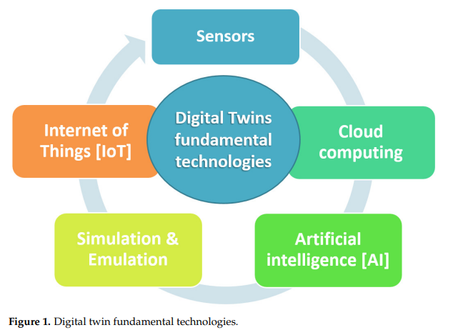
Background & Purpose
Currently, the automotive industry is moving toward the mobility innovation of the future which can refer to “CASE” framework (Connected, Autonomous, Sharing, Electric). The Digital Twins technology is one of the keys technology for this innovation.
Thus, the automotive requirement is more complex as well as testing scenario. In order to fulfill these requirements, the system & software development method has to be evolved and “Digital Twins” is one the key technology for this evolution in automotive industry.
We aim to promote digital twins trend of automotive software development industry and encourage university student to build career in automotive software development industry in Thailand.
Figure 1. Digital twin fundamental technologies
Reference: https://www.mdpi.com/2571-5577/5/4/65/htm

Slide 3

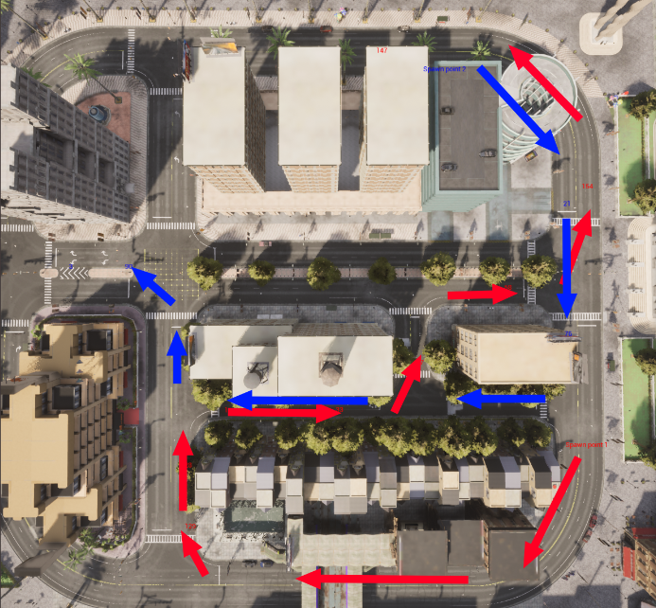
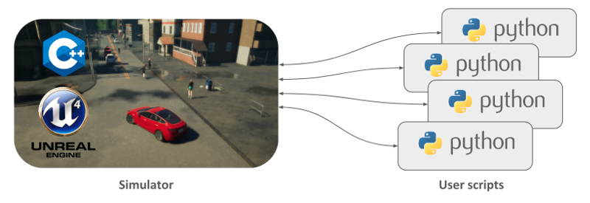
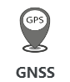

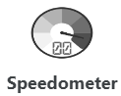
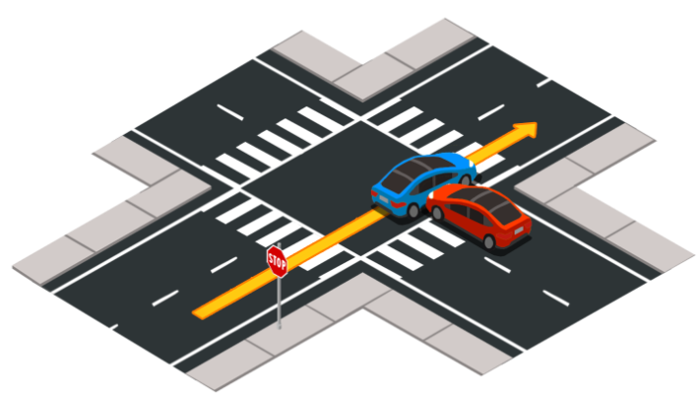

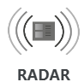
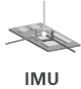
What is CARLA?
CARLA is an open-source simulator for autonomous driving research that provides open digital assets, flexible specification of sensor suites and environmental conditions to support development, training, and validation of autonomous driving systems.
This virtual simulator is also part of digital twins concept. We are going to conduct the workshop in order to create own autonomous driving control software and run simulation on CARLA environment.
Traffic manager
Sensor
Traffic scenario
Figure 2. Overall CARLA simulator
Reference: https://carla.readthedocs.io/en/latest/start_introduction

Slide 4
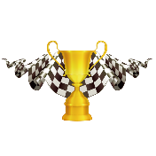



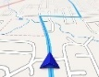
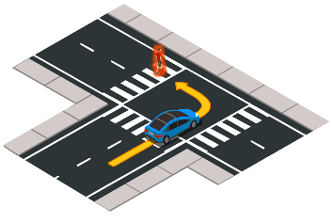


Activity Concept
CARLA Workshop & Autonomous Driving Contest
Start
Control Driving
Follow Route
Avoid
Traffic Obstacle
Finish
Figure 3. CARLA autonomous driving contest
Control your car to drive follows the specified route to the finish line.
Control your car to avoid traffic obstacle along the road.
The fastest and safest driver will win the prize.

Slide 5
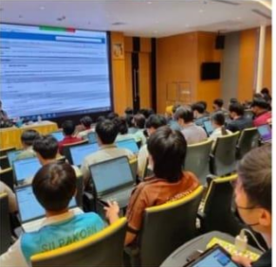
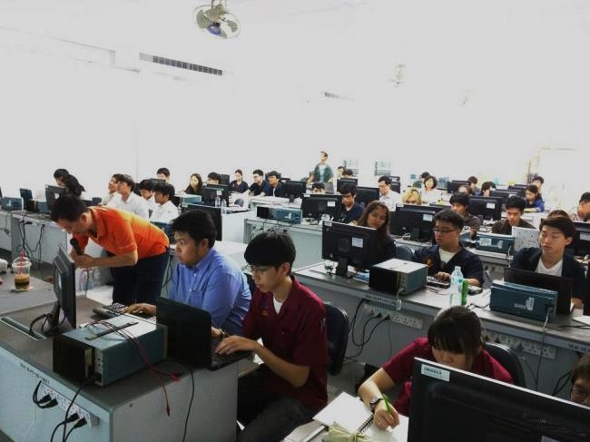
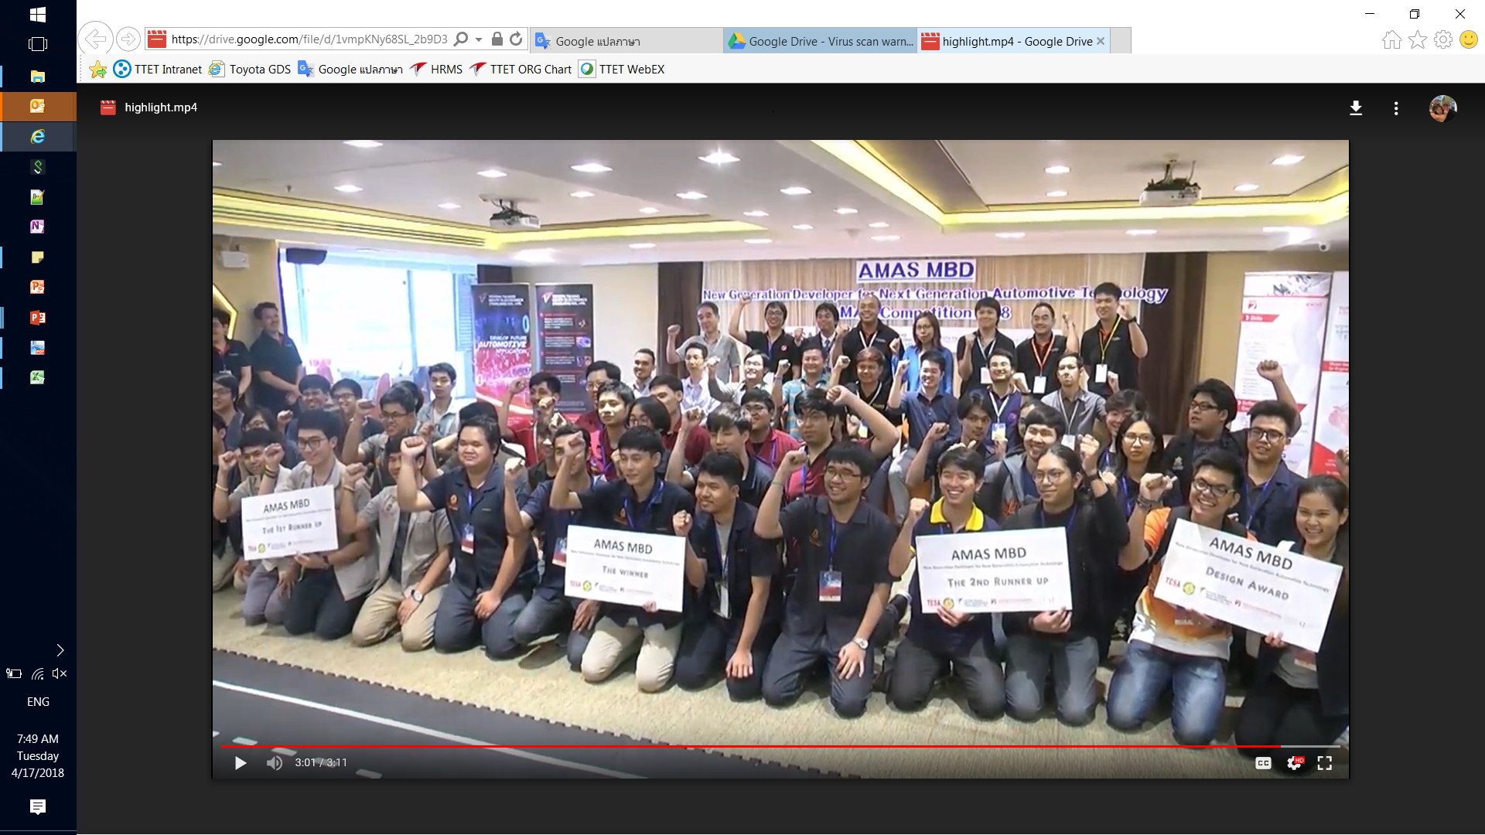
Activity Overview
Main Activities
① Registration
Open online registration from today ~ 24th Feb
Teams member not exceed 4 persons
② Event Introduction (Online session during 27th Feb ~ 5th Mar)
Explained basic technology and concept related to contest event for student to prepare before joining the Event Day. (e.g. Digital Twins, autonomous driving concept and CARLA application)
③ Event Day (2 Days on-site during 11th ~ 12th Mar)
Lecture - Learning session about sensors usage and autonomous driving control
Workshop - Hand on session to apply knowledge of sensors usage and autonomous driving control by using CARLA simulator environment.
Contest - Modify autonomous driving control software to overcome traffic situation and conduct simulation to find the best result as the winner of the event.
Lecture
Workshop
Contest

Slide 6

Prize
Items | Prize
Racing Winner | 1st : 50,000 THB 2nd : 25,000 THB 3rd : 10,000 THB
Special Prize (Best Safety Result) | 1 special prize: 10,000 THB

Slide 7
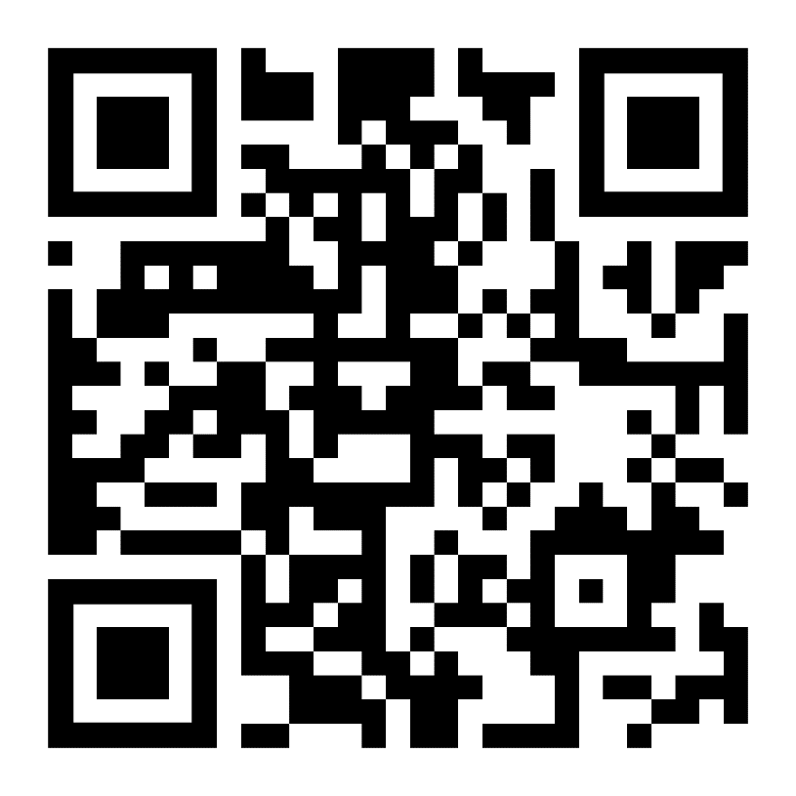
Registration
https://forms.gle/MJKXrTsgDLw2Pive6

Slide 8
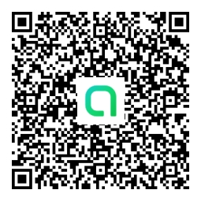
Q&A
https://line.me/ti/g2/aqfh0bv4EIGe6KGtk6rFnPuvhvHKQvX44wPzOw?utm_source=invitation&utm_medium=link_copy&utm_campaign=default

Slide 9
Appendix

Slide 10
“CASE” Framework
Connected – Vehicle communicate with other vehicle, people and infrastructure
Autonomous – Autonomous/automated self-driving vehicle
Sharing – Mobility sharing of transportation service and resources among users
Electric – Electric vehicle which is driven by electric motor

Slide 11


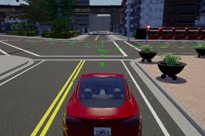
Contest Environment
Develop by Contestant
Prepared by Contest Committee
A
P
I
Driving Route
Simulator
Driving Record
VDO
Controller
Sensors
Driving Interface
Your own vehicle control software HERE!

Slide 12
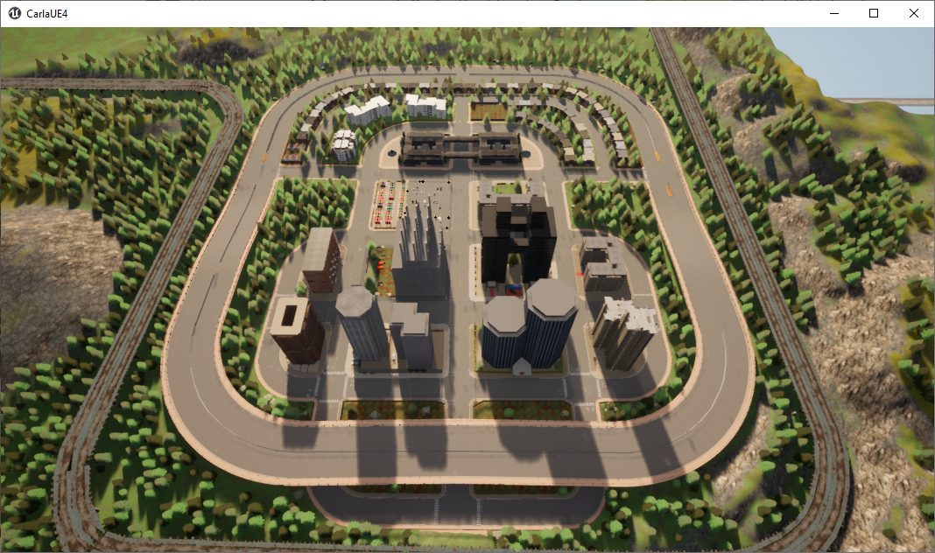
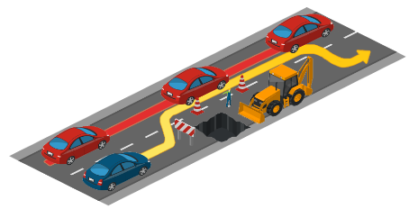
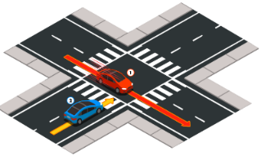

Sample Route and Obstacle
Sample Driving Route
Sample Traffic Obstacle
Situation 1: Lane changing to avoid blocking the road
Situation 2: Crossing negotiation at an unsignalize intersection.
Situation 3: Obstacle avoidance with prior action, perform an emergency brake or an avoidance.

